Slide 1
Lecture 18 Confidence Intervals

Slide 2
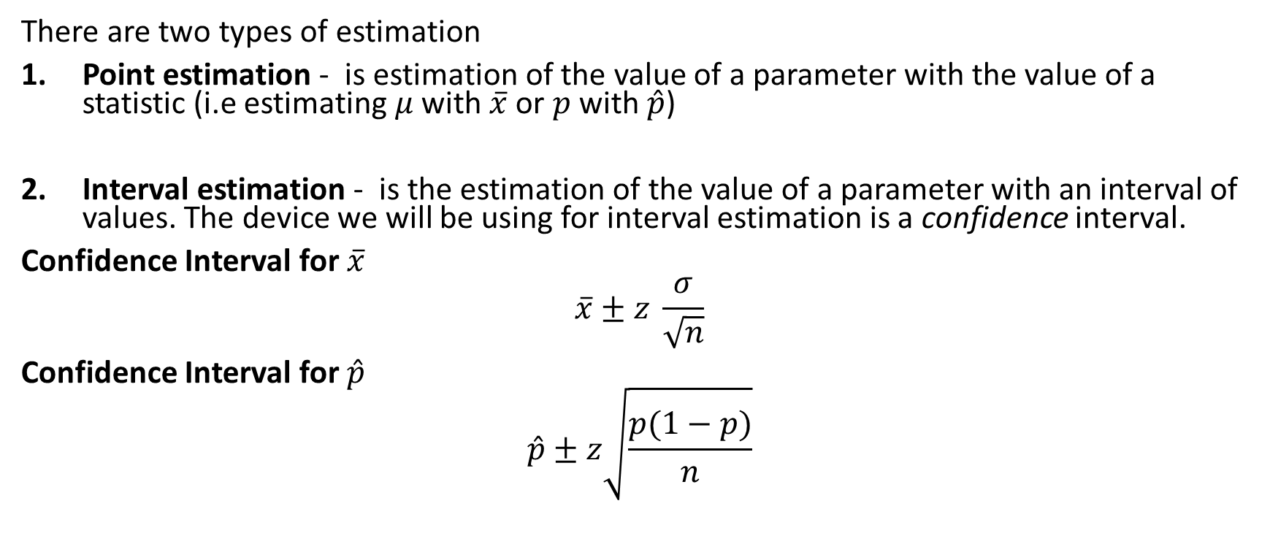
Review
There are two types of estimation
Point estimation - is estimation of the value of a parameter with the value of a statistic (i.e estimating $μ$ with $\overline{x}$ or $p$ with $\hat{p}$)
Interval estimation - is the estimation of the value of a parameter with an interval of values. The device we will be using for interval estimation is a confidence interval.
Confidence Interval for $\overline{x}$
$$\overline{x}±z \frac{σ}{\sqrt{n}}$$
Confidence Interval for $\hat{p}$
$$\hat{p}±z\sqrt{\frac{p(1−p)}{n}}$$

Slide 3
Example
Let $x$ be the yield of a chemical reaction under certain circumstances. Let $\overline{x}$ be the mean yield for a sample of 25 observations of $x$. Suppose we obtain a sample and find that $s=0.4.$ What are the (estimated) standard error and the margin of error of $\overline{x}$? Compute the 95% confidence interval for the population mean yield.

Slide 4
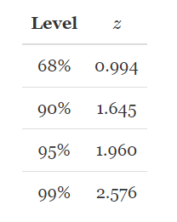
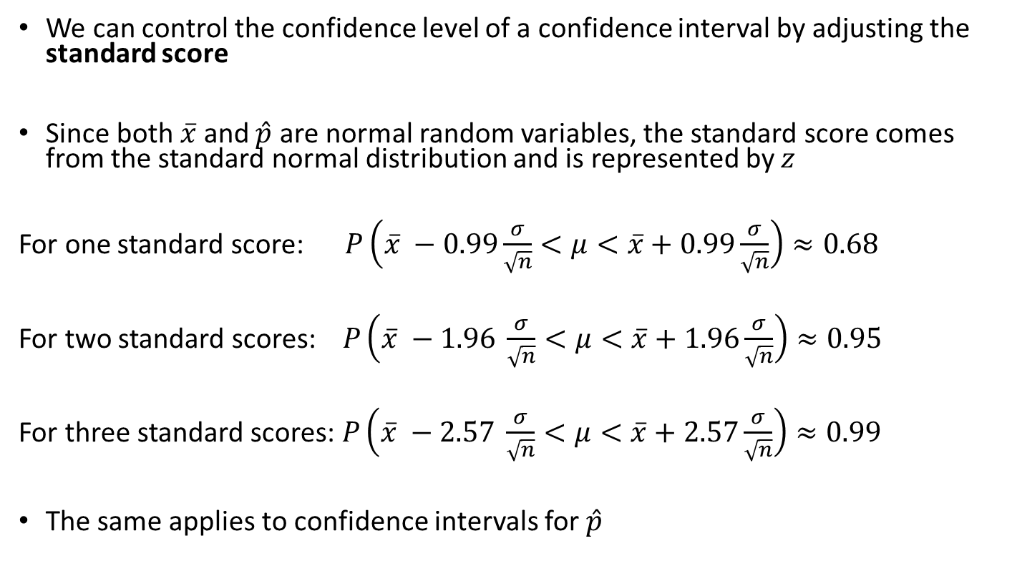
Confidence Level
We can control the confidence level of a confidence interval by adjusting the standard score
Since both $\overline{x}$ and $\hat{p}$ are normal random variables, the standard score comes from the standard normal distribution and is represented by $z$
For one standard score: $P\left(\overline{x} −0.99\frac{σ}{\sqrt{n}}<μ<\overline{x}+0.99\frac{σ}{\sqrt{n}}\right)≈0.68$
For two standard scores: $P\left(\overline{x} −1.96 \frac{σ}{\sqrt{n}}<μ<\overline{x}+1.96\frac{σ}{\sqrt{n}}\right)≈0.95$
For three standard scores: $P\left(\overline{x} −2.57 \frac{σ}{\sqrt{n}}<μ<\overline{x}+2.57\frac{σ}{\sqrt{n}}\right)≈0.99$
The same applies to confidence intervals for $\hat{p}$

Slide 5
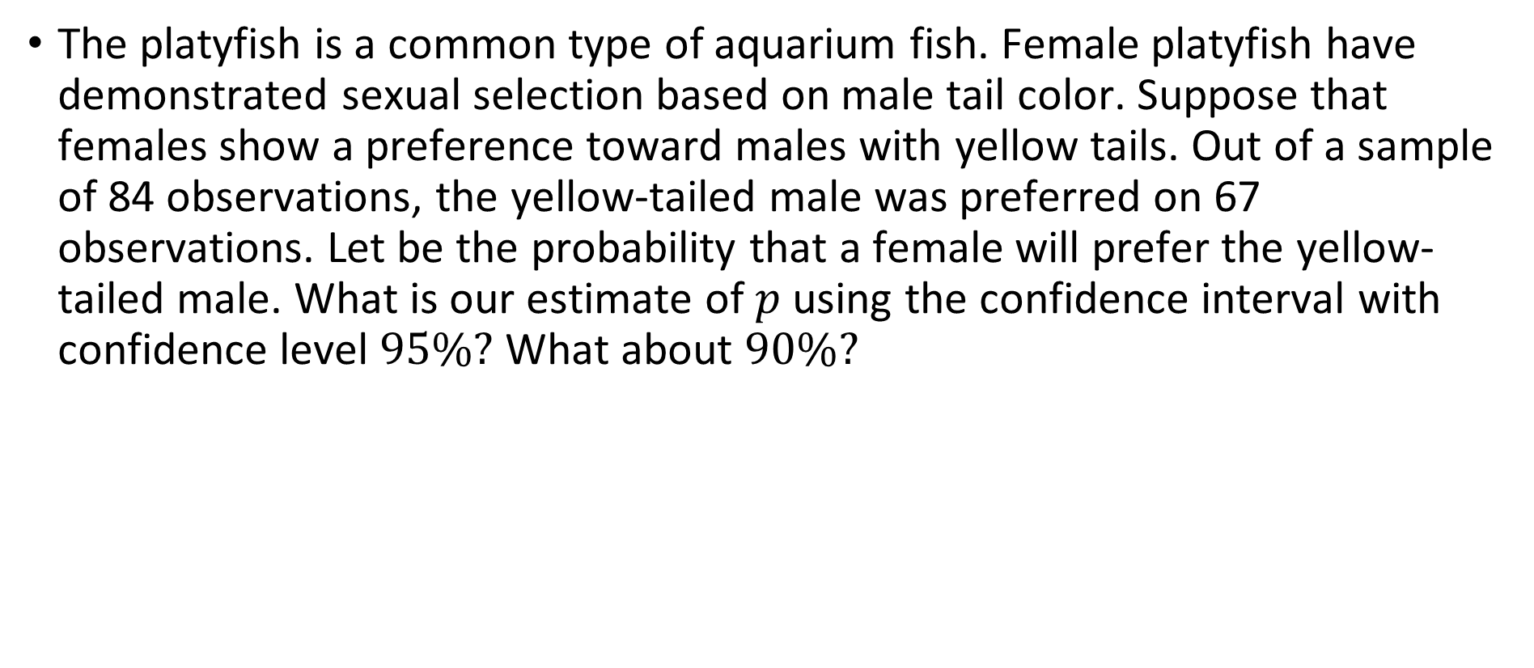
Example
The platyfish is a common type of aquarium fish. Female platyfish have demonstrated sexual selection based on male tail color. Suppose that females show a preference toward males with yellow tails. Out of a sample of 84 observations, the yellow-tailed male was preferred on 67 observations. Let be the probability that a female will prefer the yellow-tailed male. What is our estimate of $p$ using the confidence interval with confidence level $95\%?$ What about $90\%?$

Slide 6
Effects of sample size and confidence level
How does changing the confidence level effect a confidence interval?
How does changing the sample size change effect a confidence interval?

Slide 7
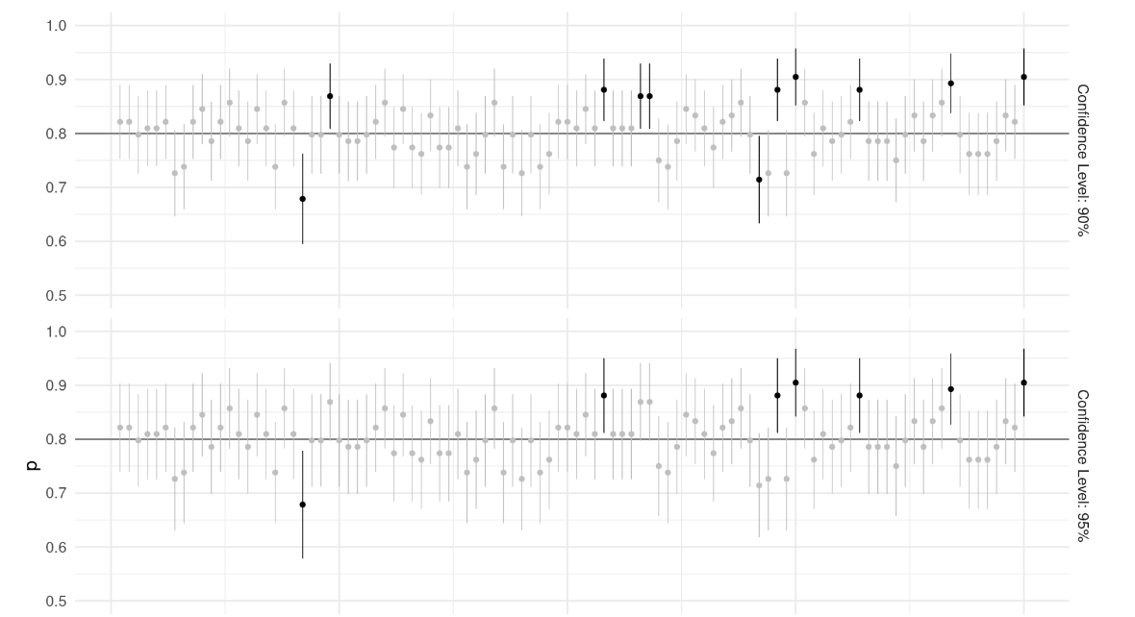

Slide 8
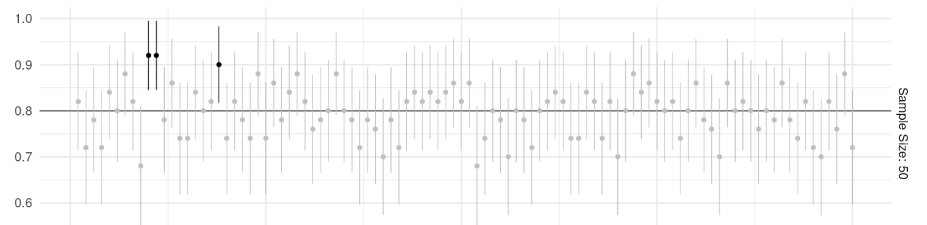
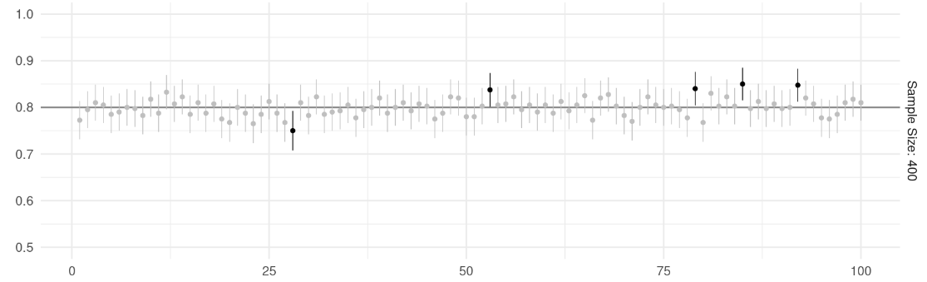

Slide 9
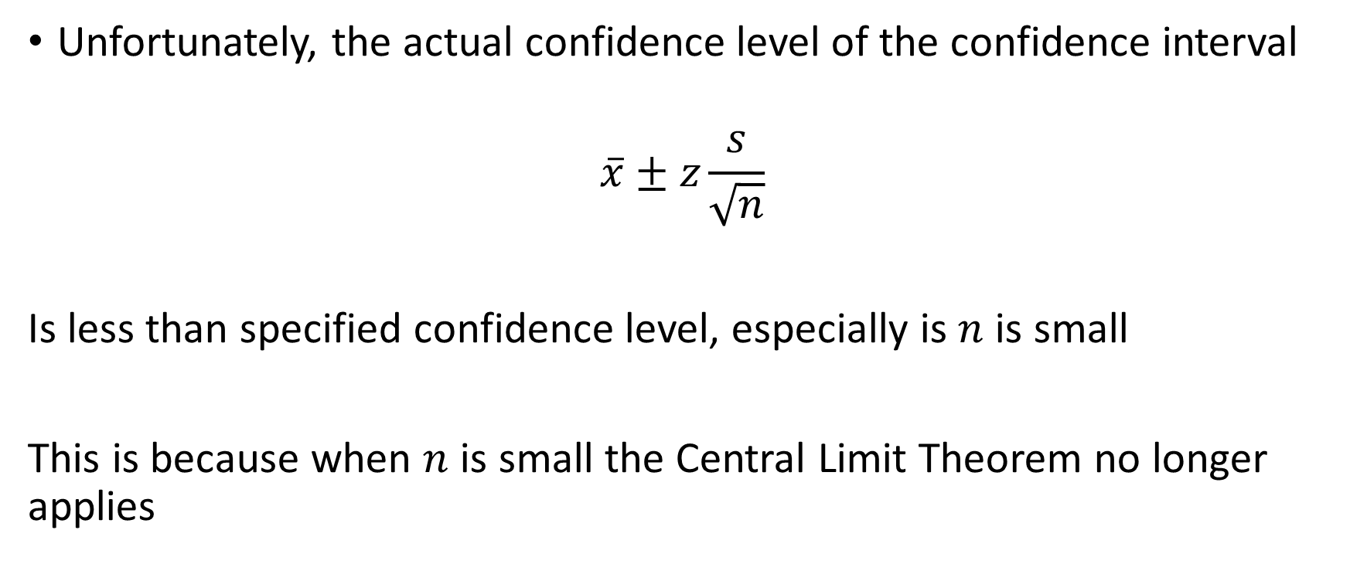

Confidence Interval for $μ$
Unfortunately, the actual confidence level of the confidence interval
$$\overline{x}±z\frac{s}{\sqrt{n}}$$
Is less than specified confidence level, especially is $n$ is small
This is because when $n$ is small the Central Limit Theorem no longer applies

Slide 10
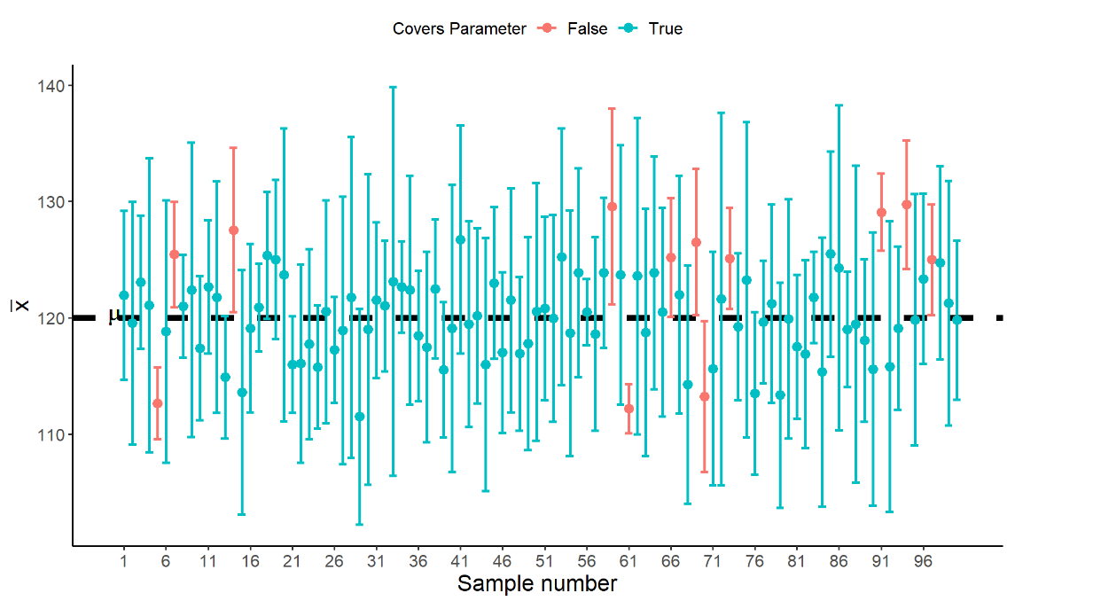

Slide 11
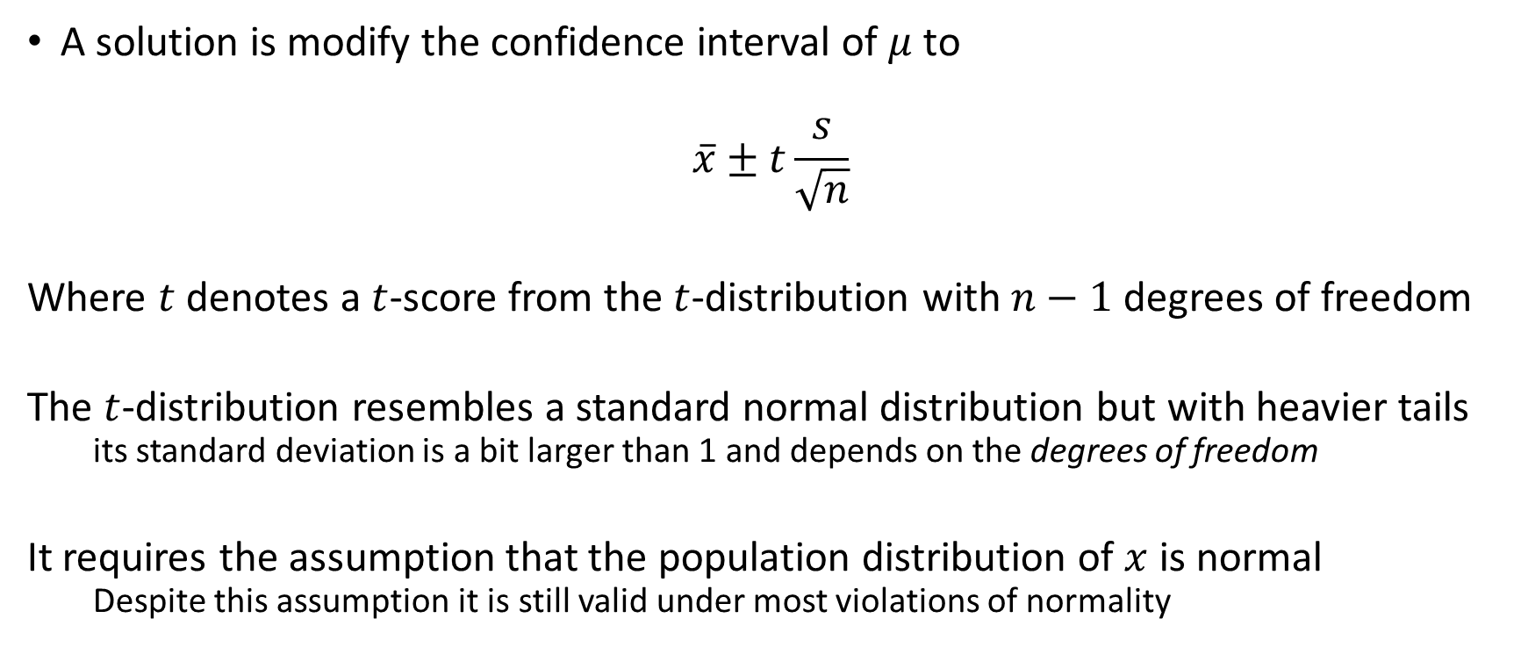

Confidence Interval for $μ$
A solution is modify the confidence interval of $μ$ to
$$\overline{x}±t\frac{s}{\sqrt{n}}$$
Where $t$ denotes a $t$-score from the $t$-distribution with $n−1$ degrees of freedom
The $t$-distribution resembles a standard normal distribution but with heavier tails
its standard deviation is a bit larger than 1 and depends on the degrees of freedom
It requires the assumption that the population distribution of $x$ is normal
Despite this assumption it is still valid under most violations of normality

Slide 12
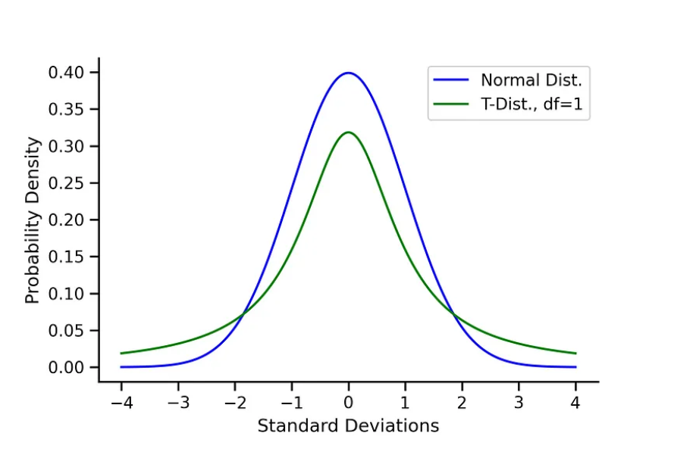

Slide 13
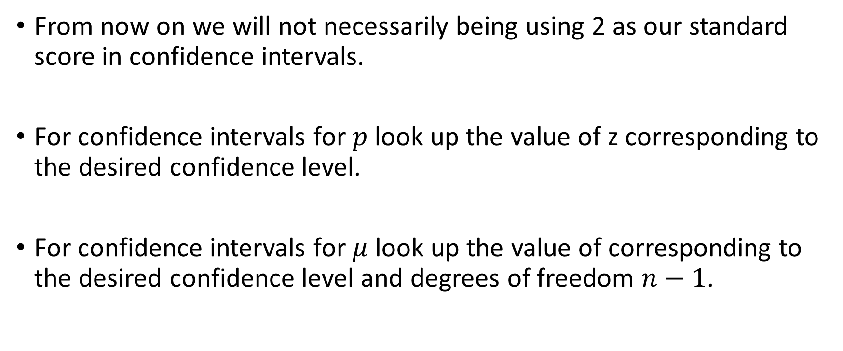
Important!
From now on we will not necessarily being using 2 as our standard score in confidence intervals.
For confidence intervals for $p$ look up the value of z corresponding to the desired confidence level.
For confidence intervals for $μ$ look up the value of corresponding to the desired confidence level and degrees of freedom $n−1$.

Slide 14

Example
A Social Survey asked “What do you think is the ideal number of children for a family to have?” 30 females were asked to give a likert response between 0 and 6 and the mean score of the recorded responses was $\overline{x}=2.56$ with standard deviation $s=0.84$

